Slide 1
Technology Skills.DATA 101.009
Final Project
Bud Latanville

Slide 2
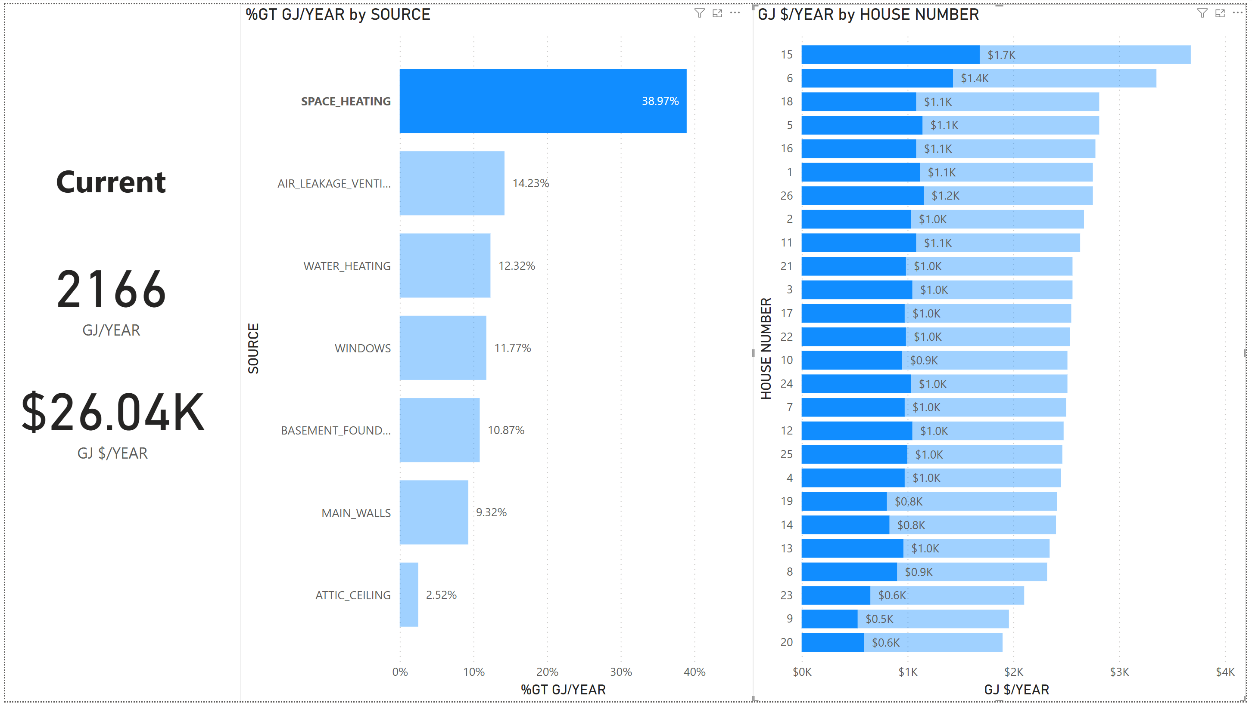
How much money is currently spent per year on space heating?

Slide 3
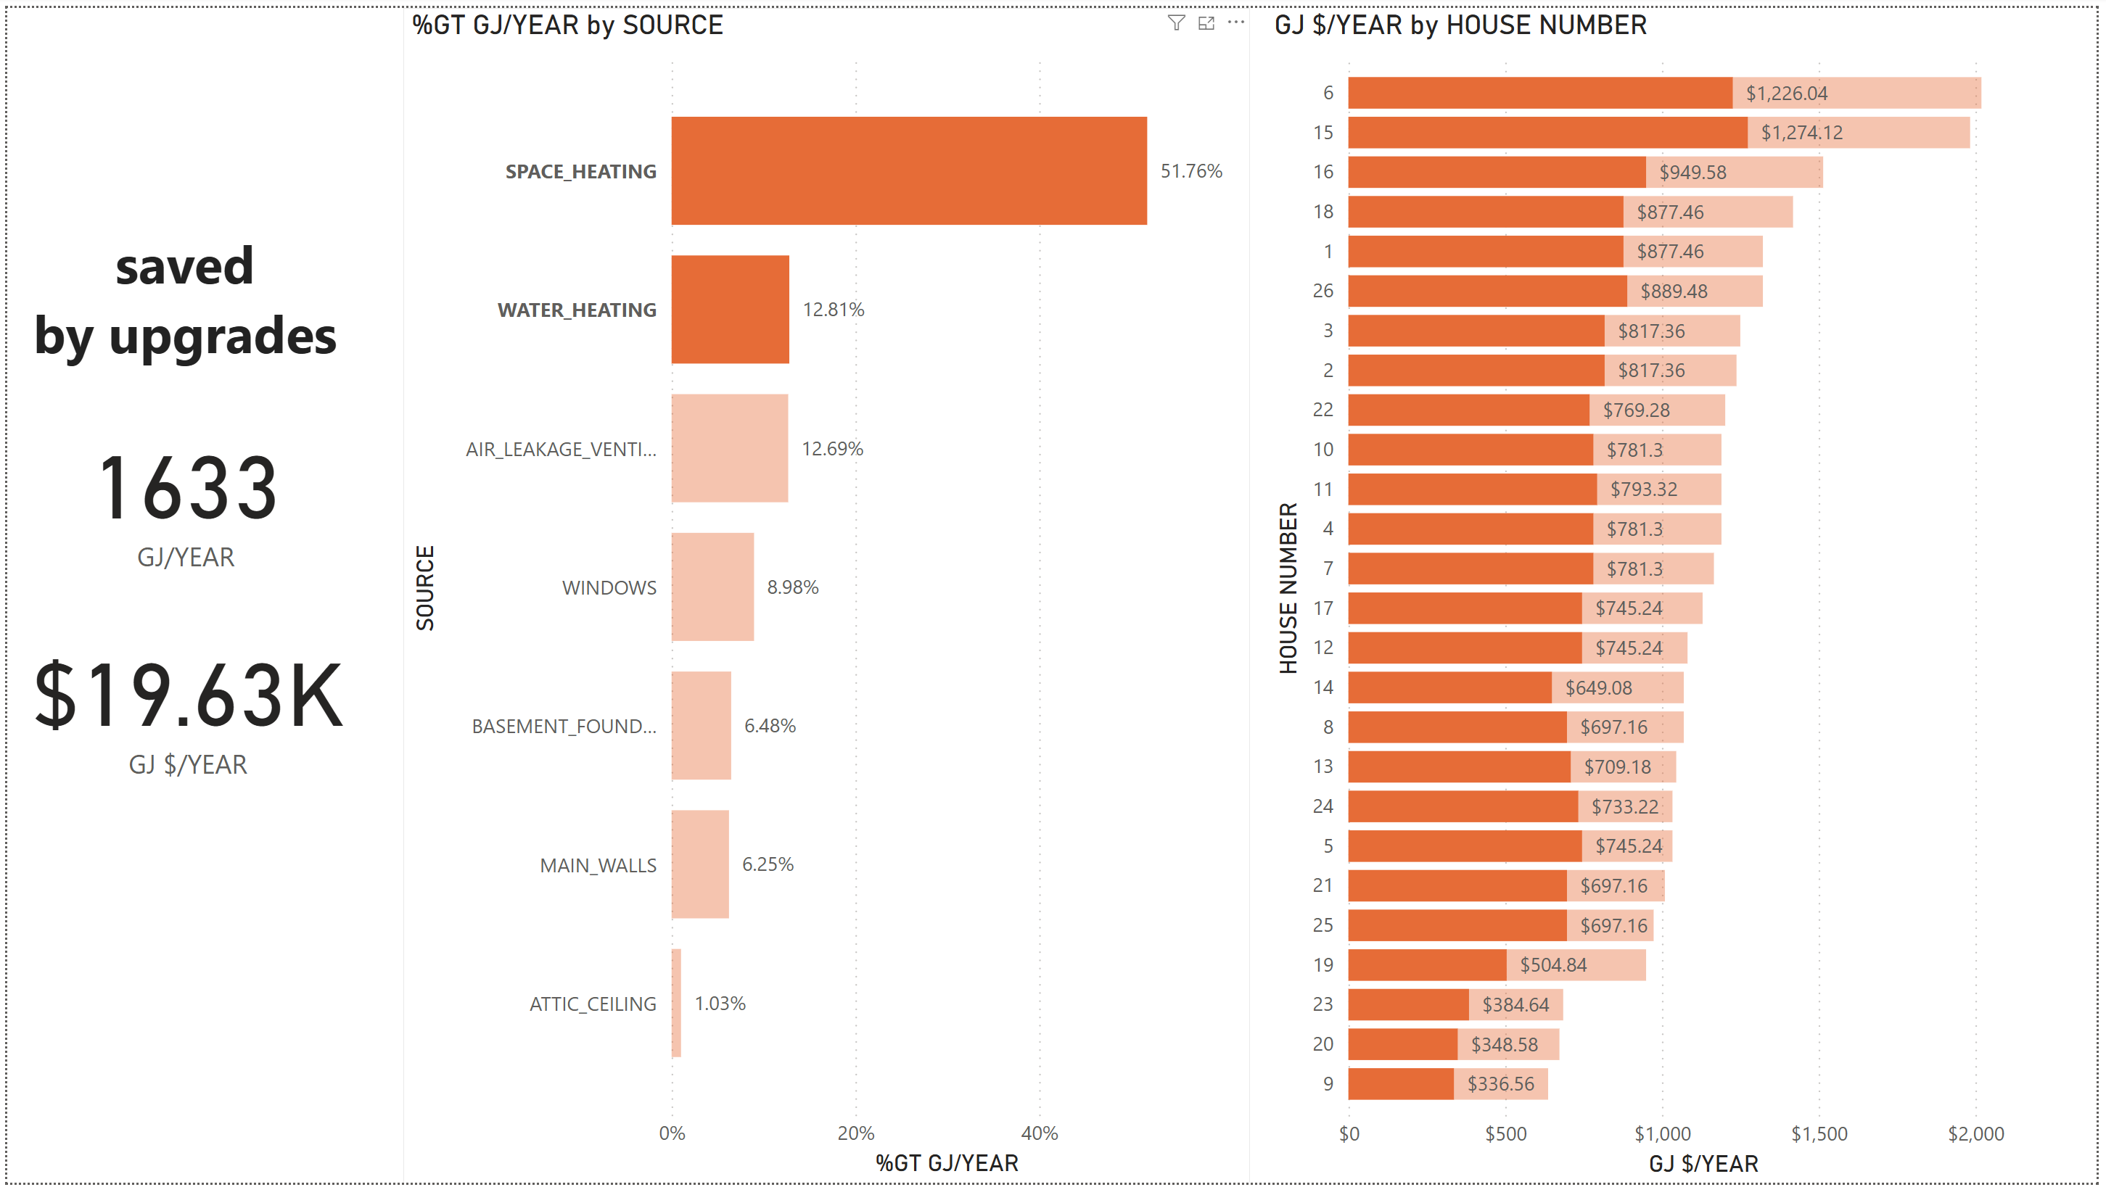
How much money could be saved per year if all 26 houses got new furnaces?

Slide 4
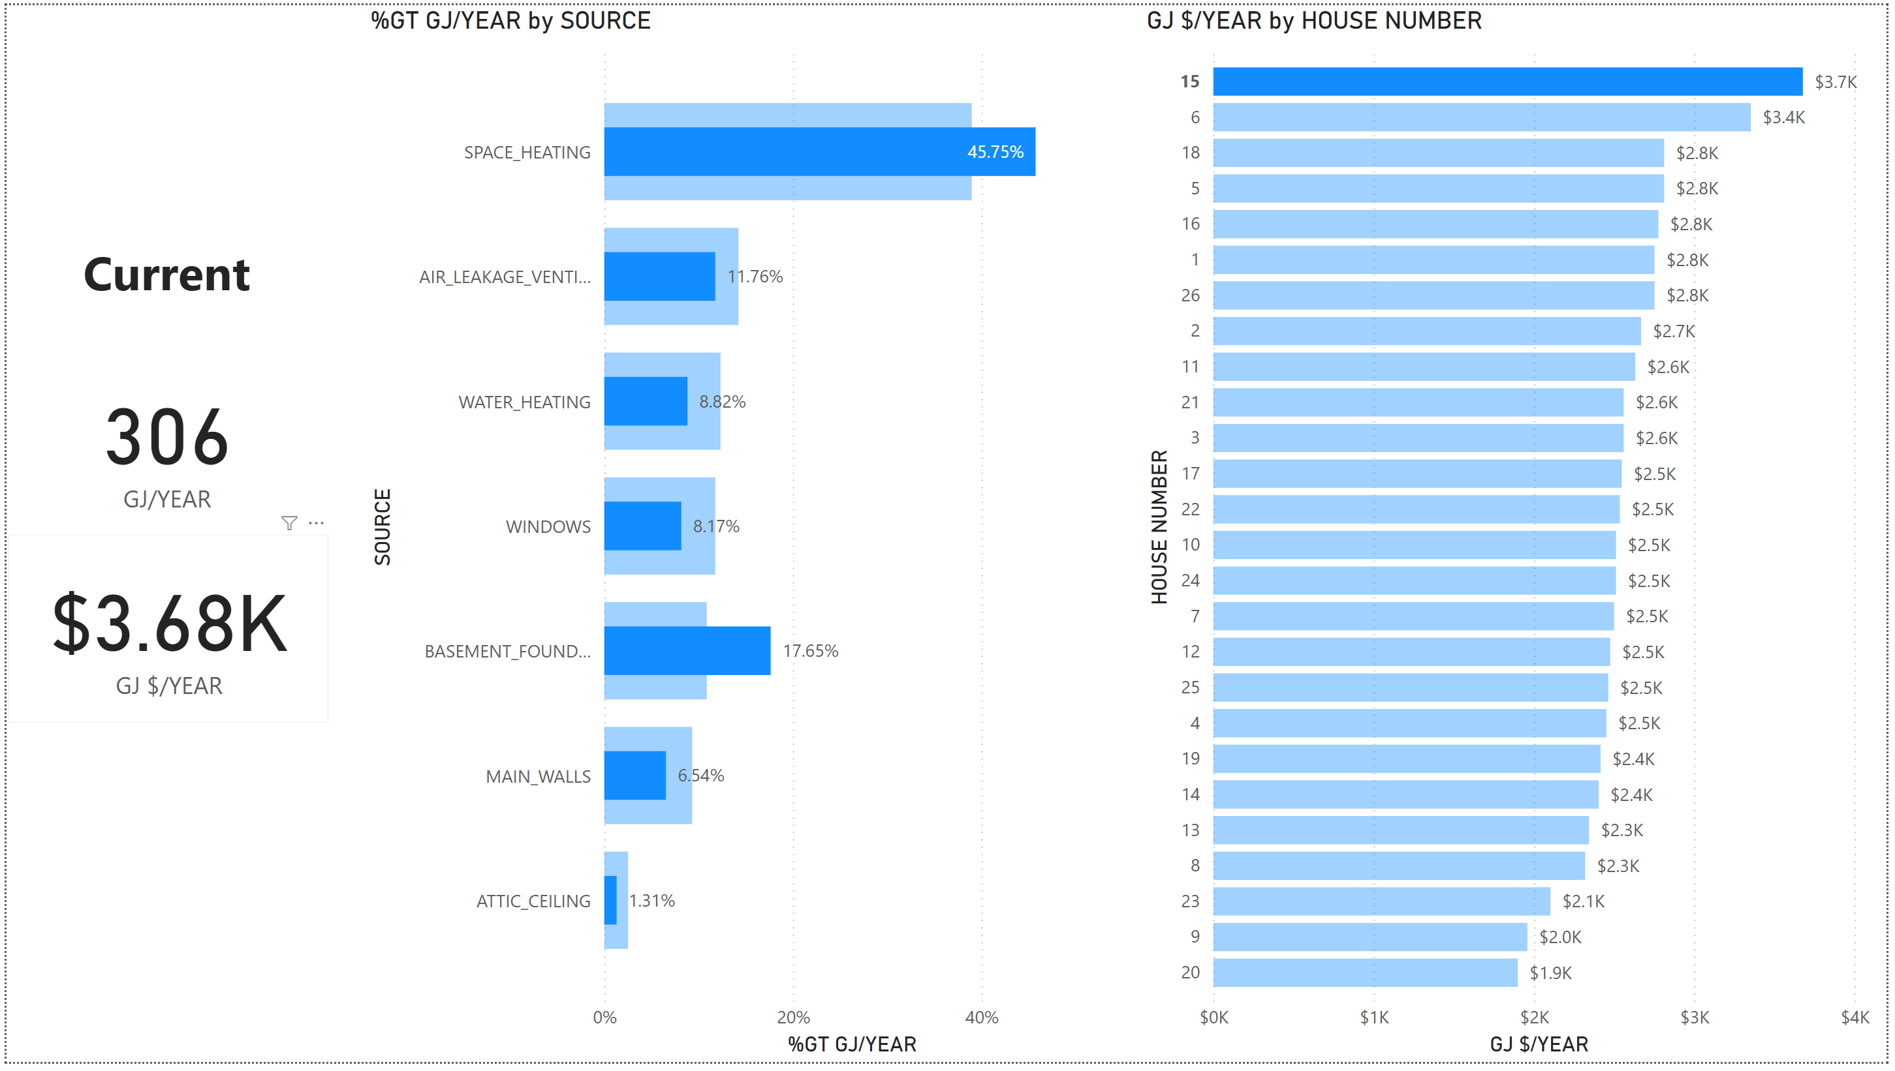
Which house currently uses the most energy?

Slide 5
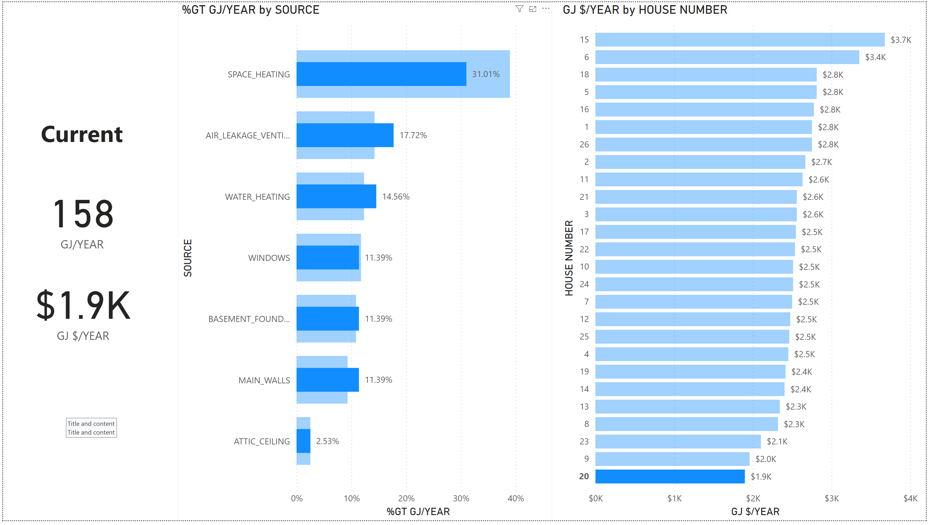
Which house currently uses the least energy?

Slide 6
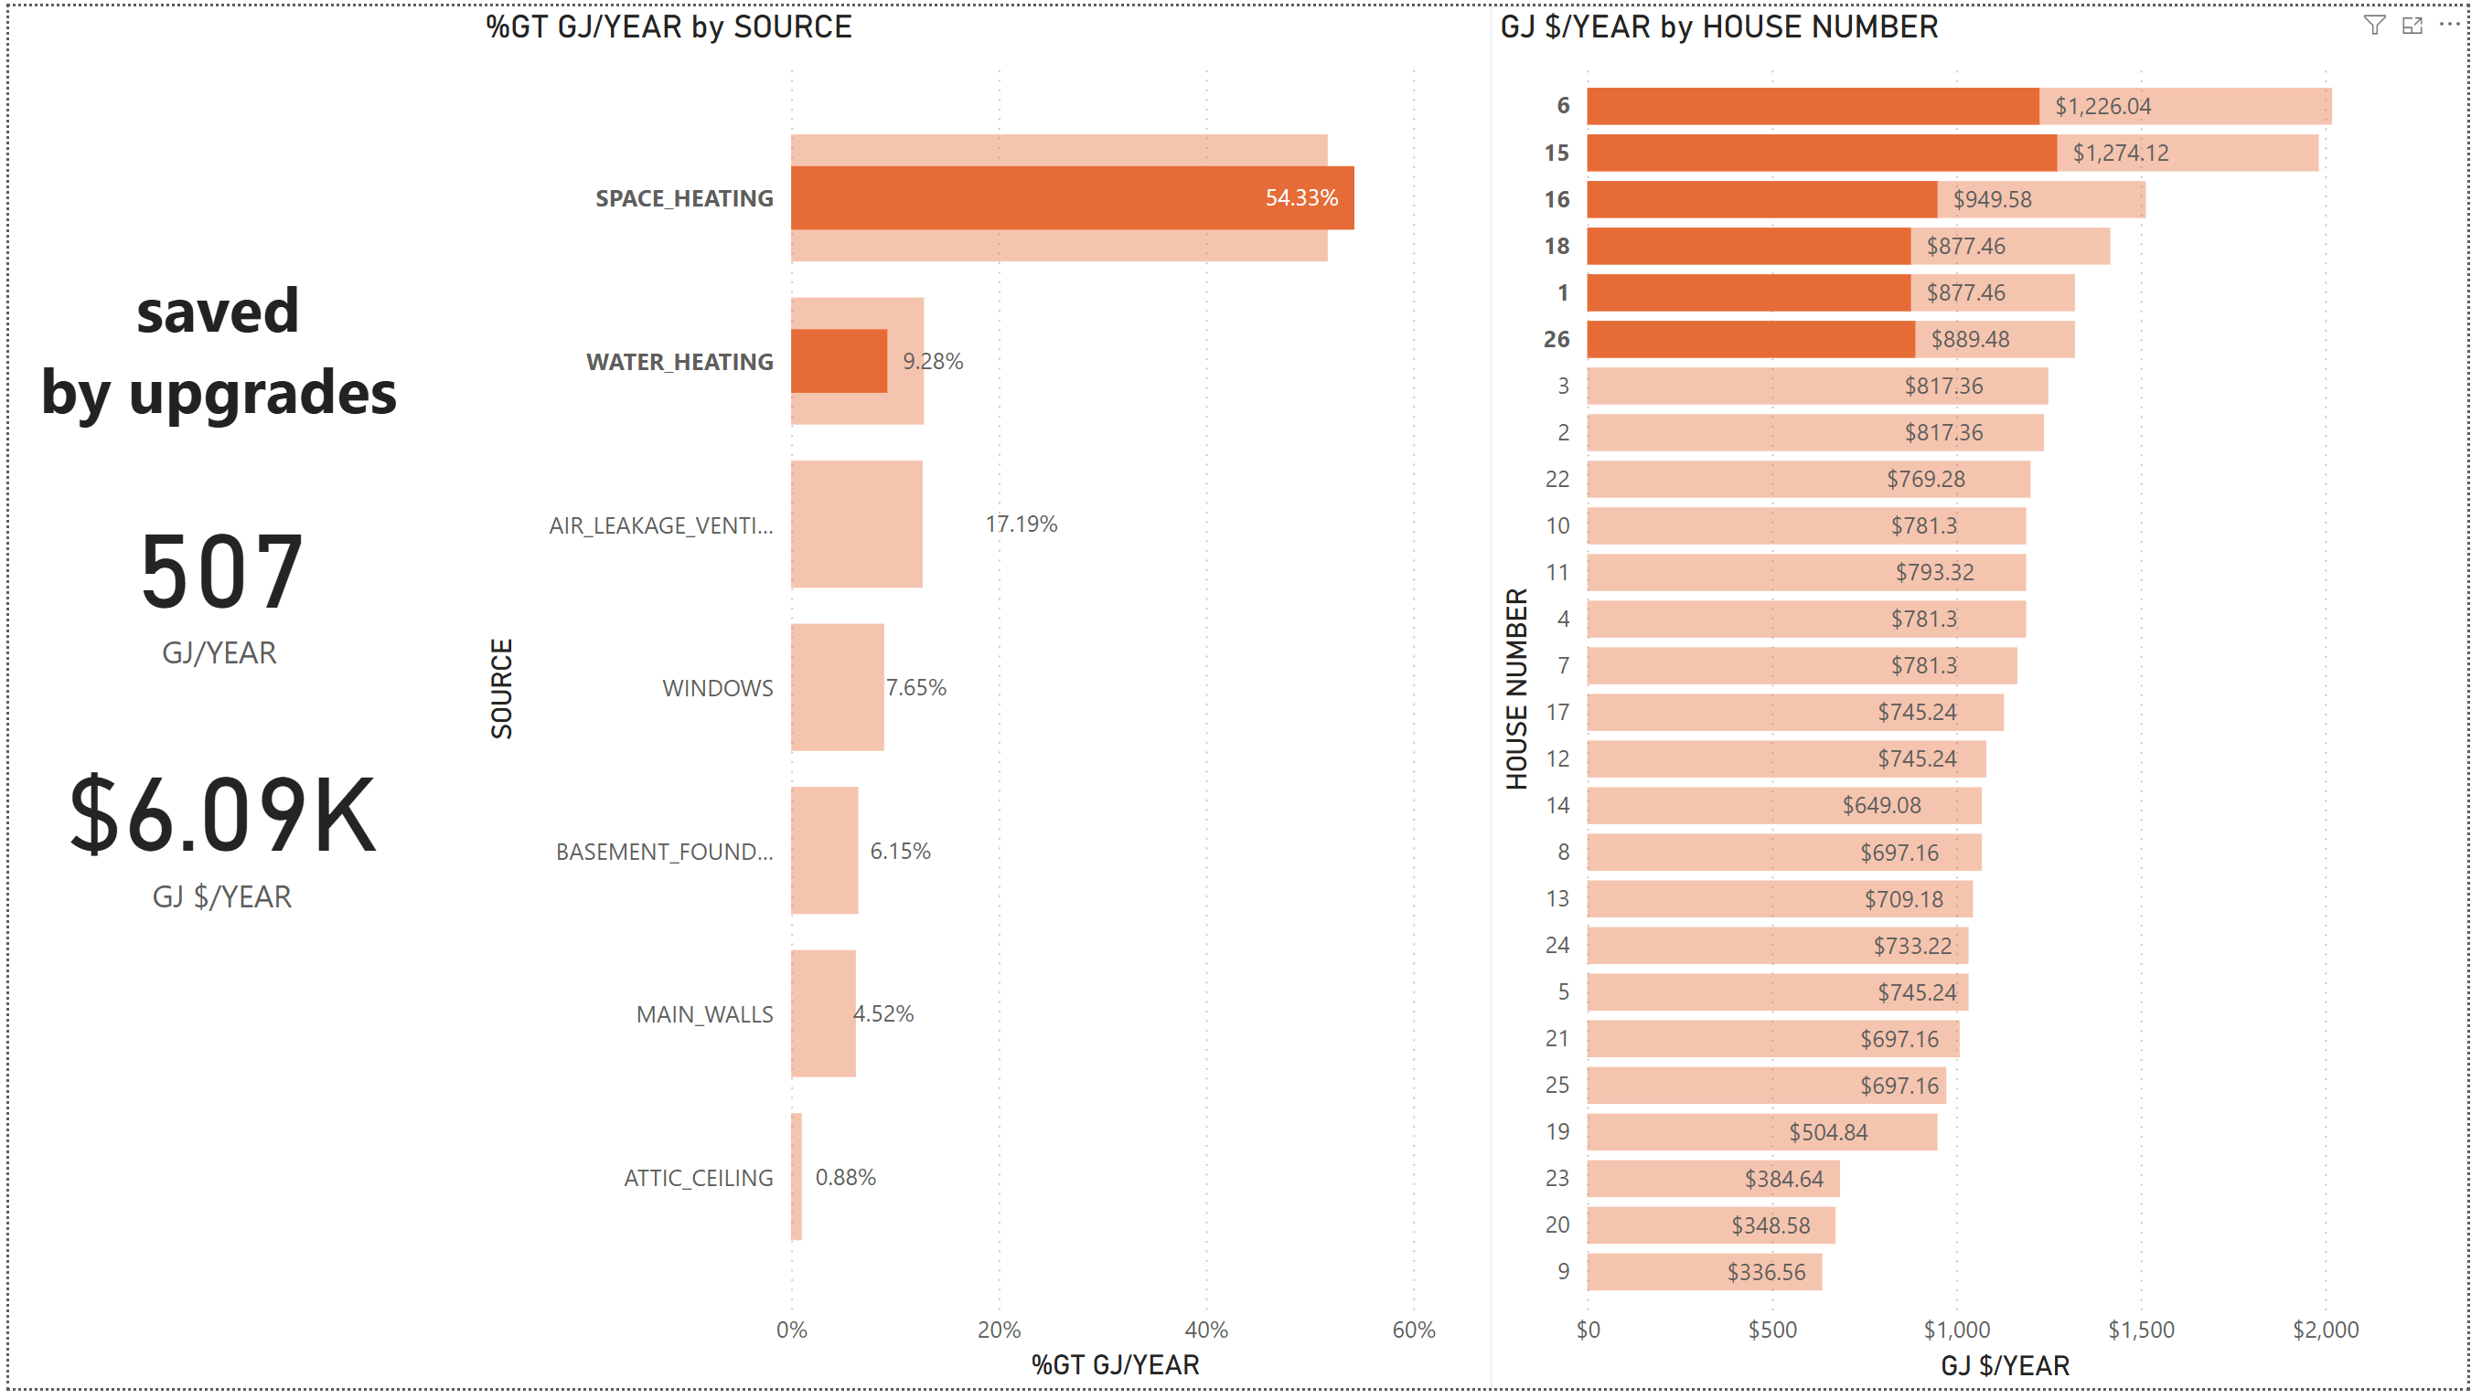
Which 5 houses would save the most money if they installed new furnaces?
In descending order, Houses
6, 15, 16, 26, and 18 & 1 (tied for savings) would save the most $/year from new furnaces.

Slide 7
End

